Slide 1

Bank analytics dashboard by group:2

Slide 2

Overview of bank dashboard
“My project is a Banking Analytics Dashboard. The main objective of this project is to analyze loan data and understand the bank's loan portfolio, funding, collections, interest, verification status, delinquency, defaults, customer information and loan trends.
we worked with the data using four technologies:
Excel, SQL, Power BI and Tableau. Excel was mainly used for data cleaning and initial analysis, SQL was used for querying and calculating important metrics, and Power BI and Tableau were used to create interactive dashboards and visualizations.”

Slide 3
What we learned in this banking analytics dashboard
“Through this Banking Analytics Dashboard project, we learned the complete process of data analysis, starting from raw data and ending with a business dashboard.
We learned how to clean and prepare data in Excel, use Pivot Tables and formulas for initial analysis, and use SQL to query, filter, group and aggregate data.
We learned how to create KPIs and calculated measures such as Total Loans, Total Funded Amount, Total Collection, Total Interest, Verified Loans, Delinquent Loans, Delinquent Rate, Default Loans and Default Rate.
We also learned how to use Power BI and Tableau to create interactive dashboards, including KPI cards, charts, slicers, filters and proper dashboard formatting.
Most importantly, we learned how to convert raw banking data into meaningful business insights, identify loan trends and understand areas such as funding, collections, verification and loan risk.”

Slide 4

Problem’s we faced through this project
Data cleaning: We faced blank and missing values in the banking data, so we had to clean the data before analysis.
Understanding the data: There were many columns, so initially it was difficult to understand which columns should be used for each KPI and chart.
SQL and DAX errors: We faced some errors while writing SQL queries and Power BI DAX formulas, especially with table and column names.
Null values in Power BI: When we imported the wrong sheet, many values appeared as null. We solved this by importing the original Banking Data sheet.
Alignment and formatting: The KPI cards, charts, slicers and text were not properly aligned at first. We adjusted their size, position and spacing to make the dashboard look professional.
Chart selection: It was difficult to choose the right chart for each type of data, so we selected charts based on what we wanted to show clearly.

Slide 5
What all kpi’s are used for the dashboard
🏦 Loan Analytics Dashboard -4 kpis
Total Loans – Total number of loans in the dataset.
Total Funded Amount – Total amount funded by the bank.
Total Collection – Total amount collected from customers.
Default Rate – Percentage of loans that are in default.
💳 Credit & Debit Dashboard – 4 KPIs
Total Credit Amount – Total amount credited through transactions.
Total Debit Amount – Total amount debited through transactions.
Credit to Debit Ratio – Compares the total credit amount with the total debit amount.
Net Transaction Amount – Difference between the total credit and debit amounts.

Slide 6
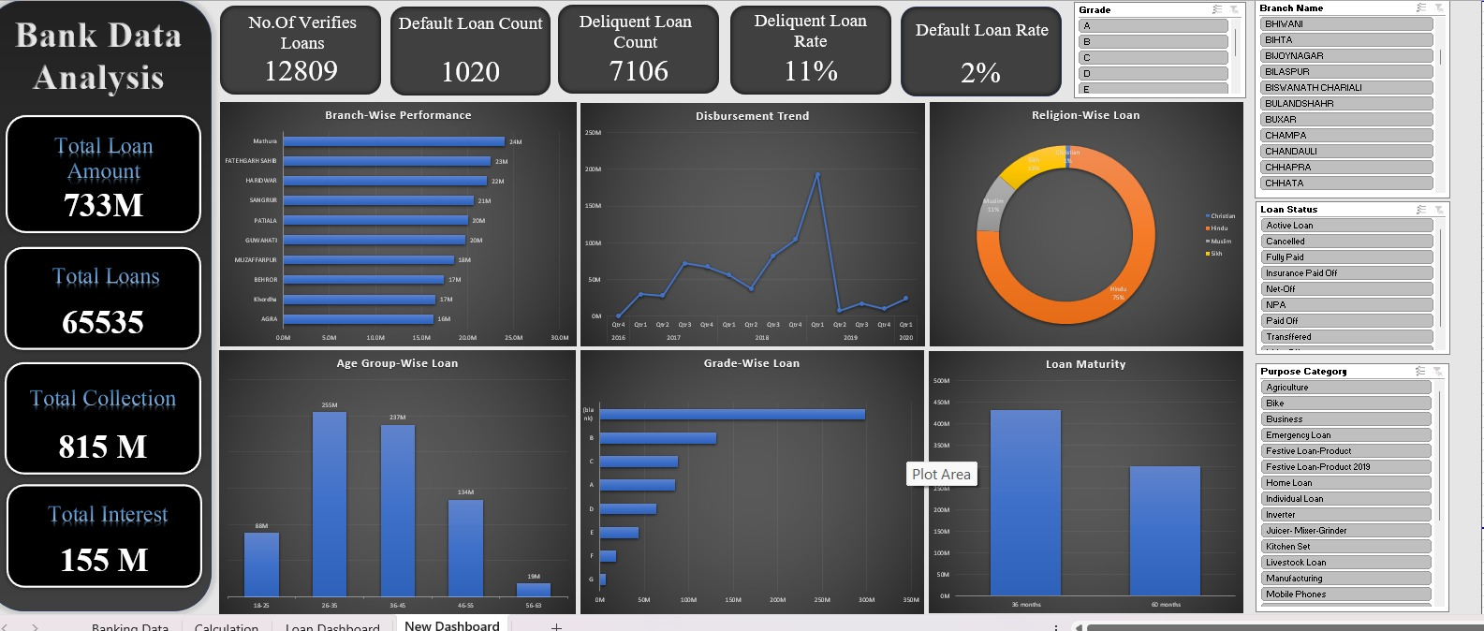
Excel loan dashboard:
Data Cleaning – We cleaned the raw banking data and handled blank or missing values.
Sorting & Filtering – We filtered and sorted the data to analyze specific loans, transactions, banks and branches.
Formulas – We used Excel formulas to calculate totals, percentages and important metrics.
Pivot Tables – We created Pivot Tables to summarize loans, funding, credit, debit and transactions.
KPI Calculation – We calculated important KPIs such as Total Loans, Total Funded Amount, Total Credit Amount and Total Debit Amount.
Data Analysis – We used the Excel results to understand trends and prepare the data for Power BI and Tableau dashboards.

Slide 7
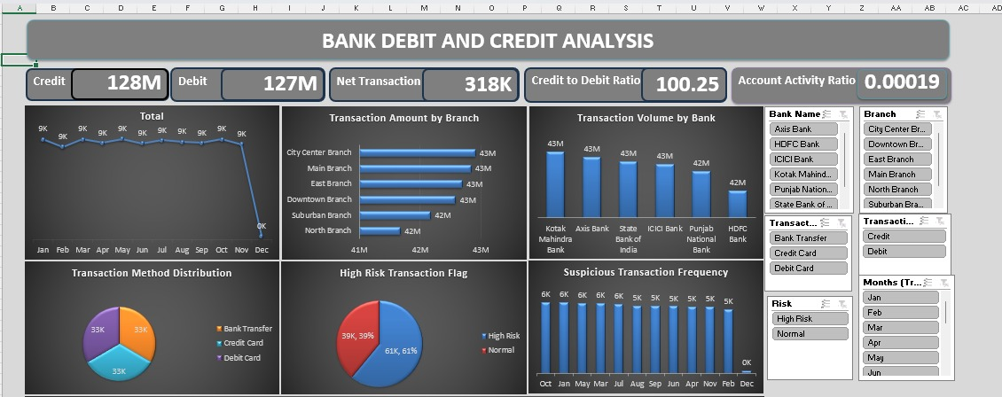
Excel credit and debit dashboard:
Data Cleaning – We cleaned the transaction data and handled blank or incorrect values.
Sorting & Filtering – We filtered transactions based on bank, branch, month, transaction type and transaction method.
Pivot Tables – We used Pivot Tables to summarize credit amount, debit amount and transaction volume.
KPI Calculation – We calculated important KPIs such as Total Credit Amount, Total Debit Amount, Credit-to-Debit Ratio and Net Transaction Amount.
Transaction Analysis – We analyzed monthly transactions, bank-wise and branch-wise transaction amounts, and identified high-risk and suspicious transactions.
Data Preparation – We prepared the analyzed data so it could be used to create the Power BI/Tableau dashboard.

Slide 8
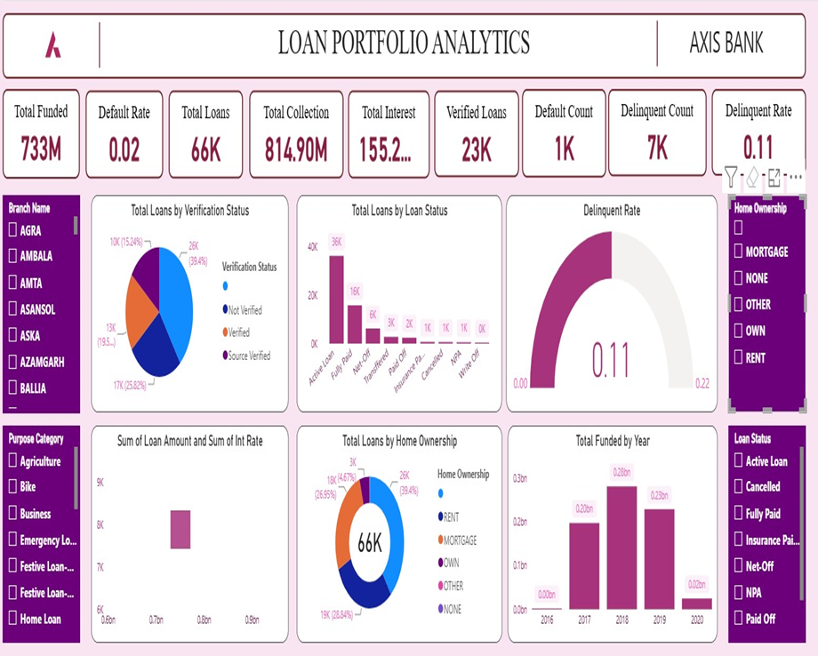
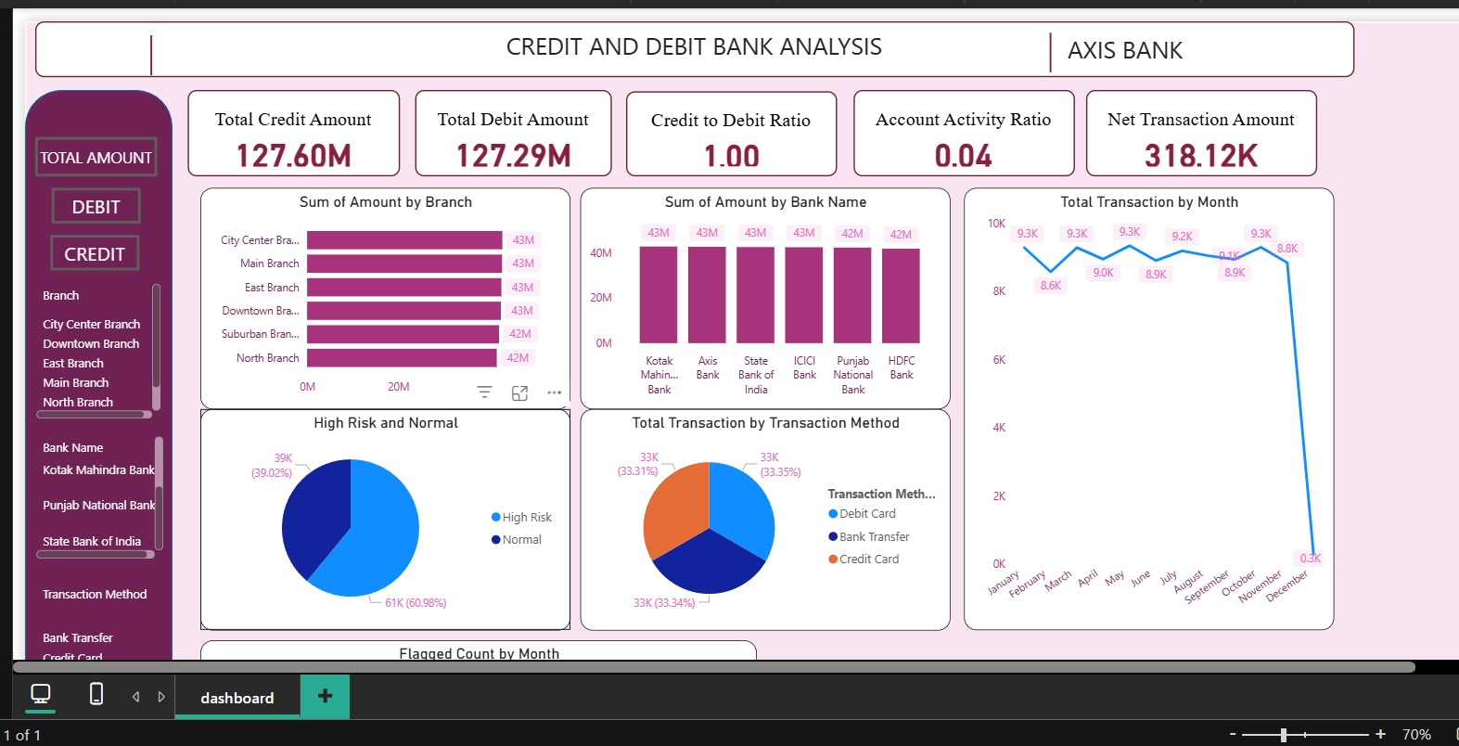
Power bi loan and credit dashboard:

Slide 9
Power bi loan and credit dashboard:
Data Import & Cleaning – We imported both datasets into Power BI and cleaned them using Power Query.
KPI Creation – We created DAX measures for important KPIs like Total Loans, Funded Amount, Credit Amount, Debit Amount and Default Rate.
Data Visualization – We created different charts to analyze loans, transactions, banks, branches, loan status and trends.
Interactive Filters – We added slicers and filters to analyze the data based on different categories.
Dashboard Formatting – We worked on alignment, sizing, data labels, currency and percentage formatting to make the dashboards clear and professional.
Final Analysis – We used the dashboards to identify loan performance, transaction activity, high-risk transactions and other important business insights.

Slide 10
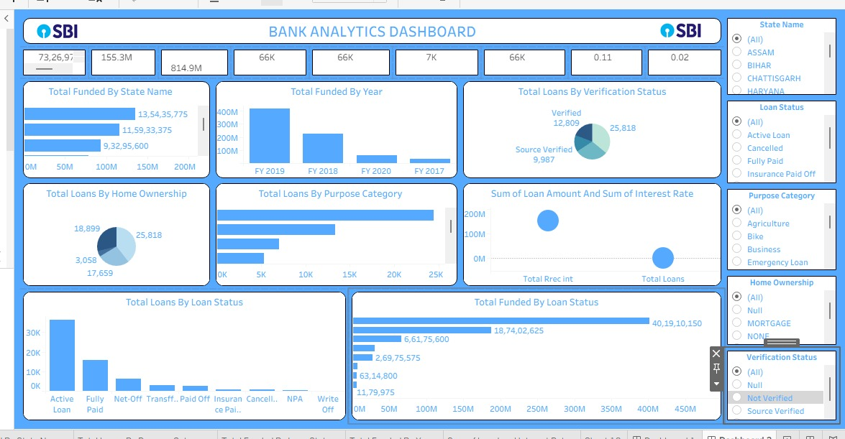
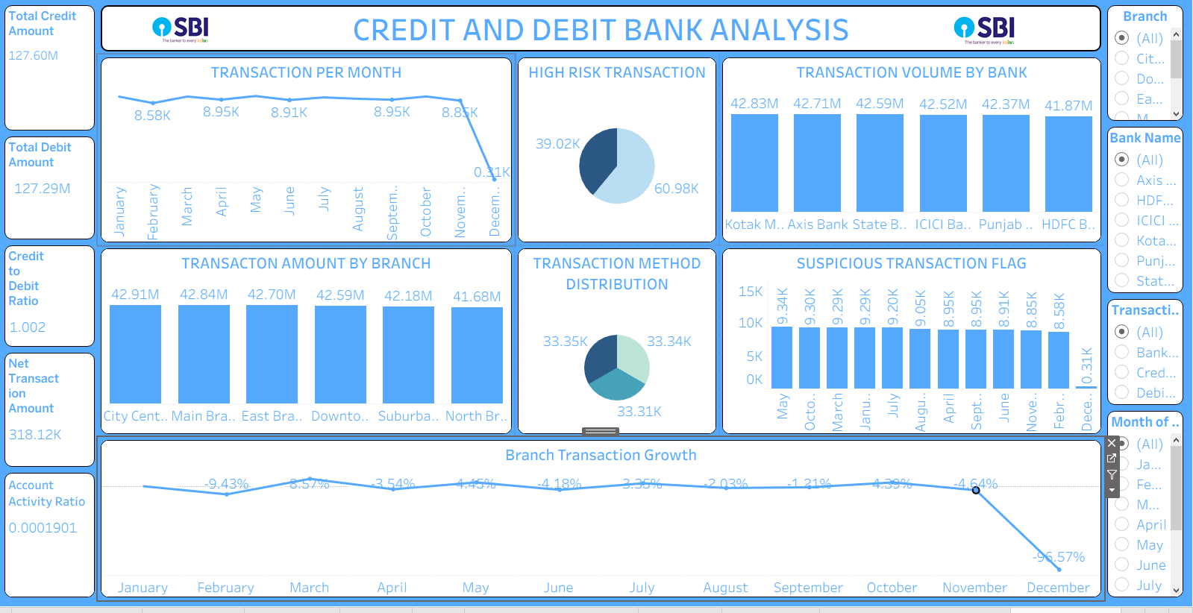
Tableau loan and credit dashboard:

Slide 11
tableau loan and credit dashboard:
Data Connection – We connected the banking data to Tableau and prepared it for analysis.
Calculated Fields – We created calculated fields for important KPIs such as Total Loans, Funded Amount, Credit Amount and Debit Amount.
KPI Cards – We created KPI cards to display the main business metrics clearly.
Charts & Visualizations – We created charts to analyze loan status, funding trends, transactions, banks, branches and transaction methods.
Filters & Interactivity – We added filters to allow users to analyze the dashboards based on different categories.
Dashboard Design – We worked on alignment, sizing, formatting and proper placement of charts and KPIs to create a clean and professional dashboard.

Slide 12
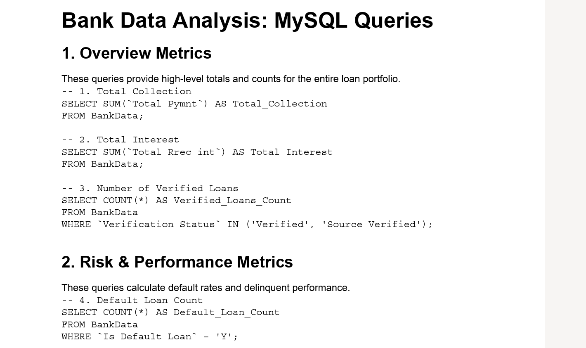
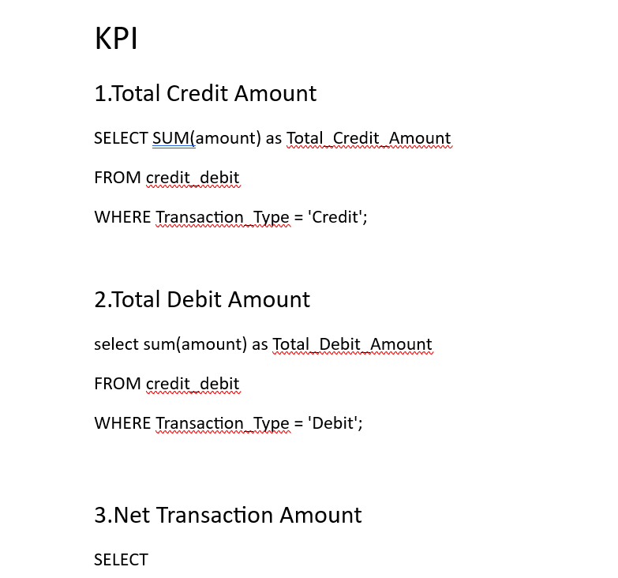

Slide 13
my sql queries for loan and credit dashboard:
Database & Table Creation – We created a database and stored the banking data in tables.
Data Retrieval – We used SELECT queries to retrieve the required loan and transaction data.
Filtering Data – We used WHERE conditions to filter data based on loan status, verification, banks, branches and transaction types.
KPI Calculation – We used functions like COUNT() and SUM() to calculate KPIs such as Total Loans, Total Funded Amount, Total Credit Amount and Total Debit Amount.
Data Grouping – We used GROUP BY to analyze data by year, state, bank, branch, loan status and transaction method.
Data Analysis & Validation – We compared SQL results with Excel and used the results for our Power BI and Tableau dashboards.

Slide 14

THANK YOU
BY GROUP: 2

